Slide 1
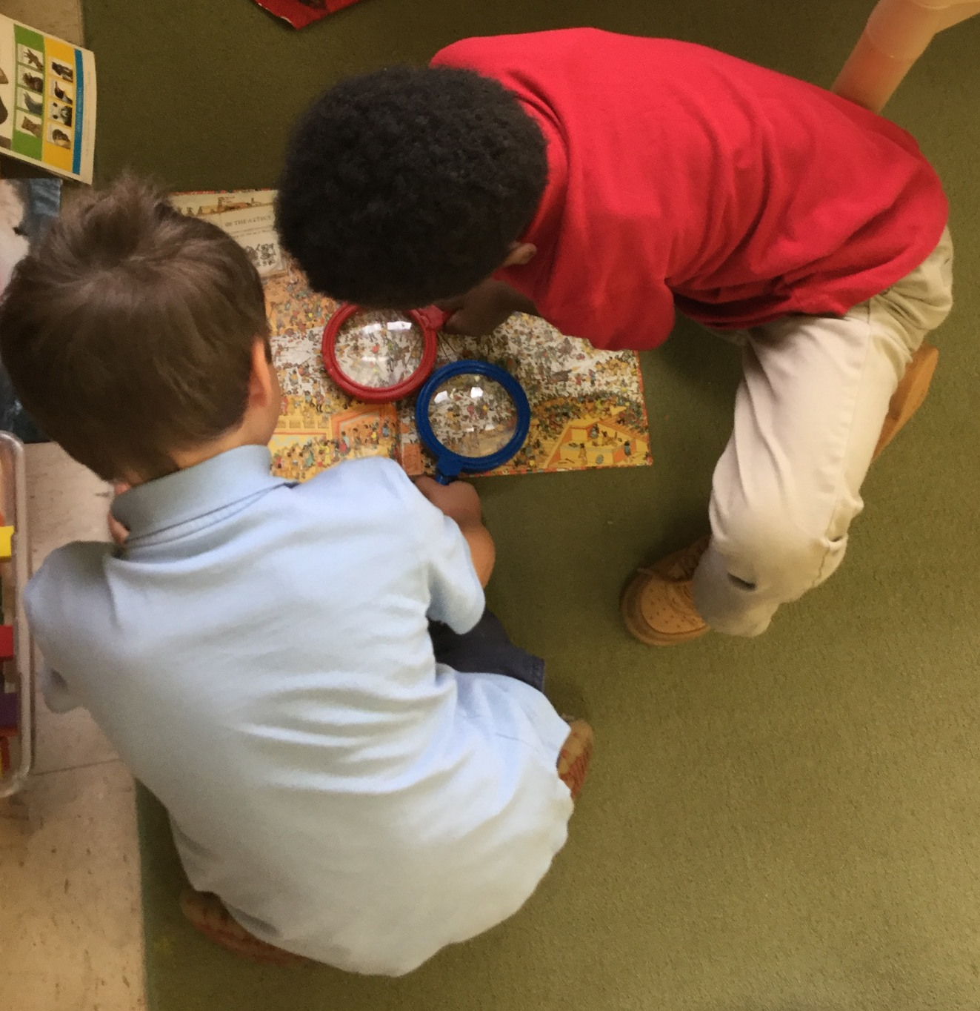
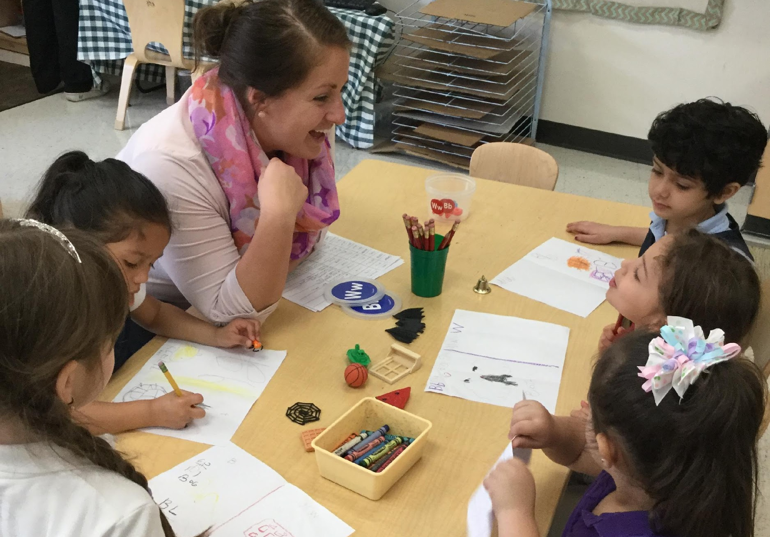
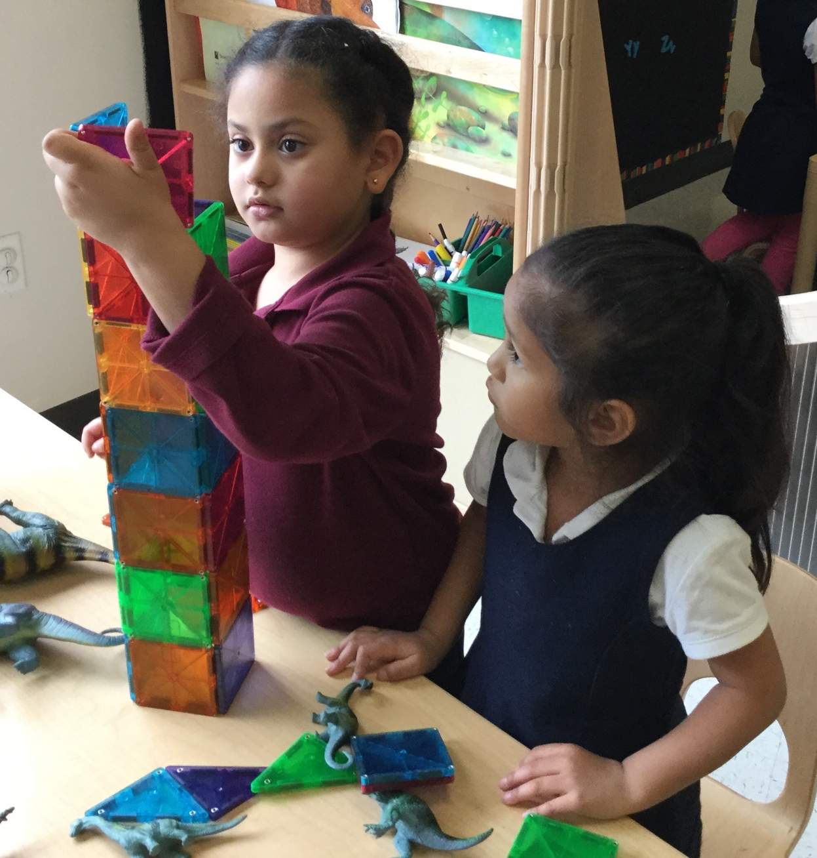
Planning Sequential Activities

Slide 2
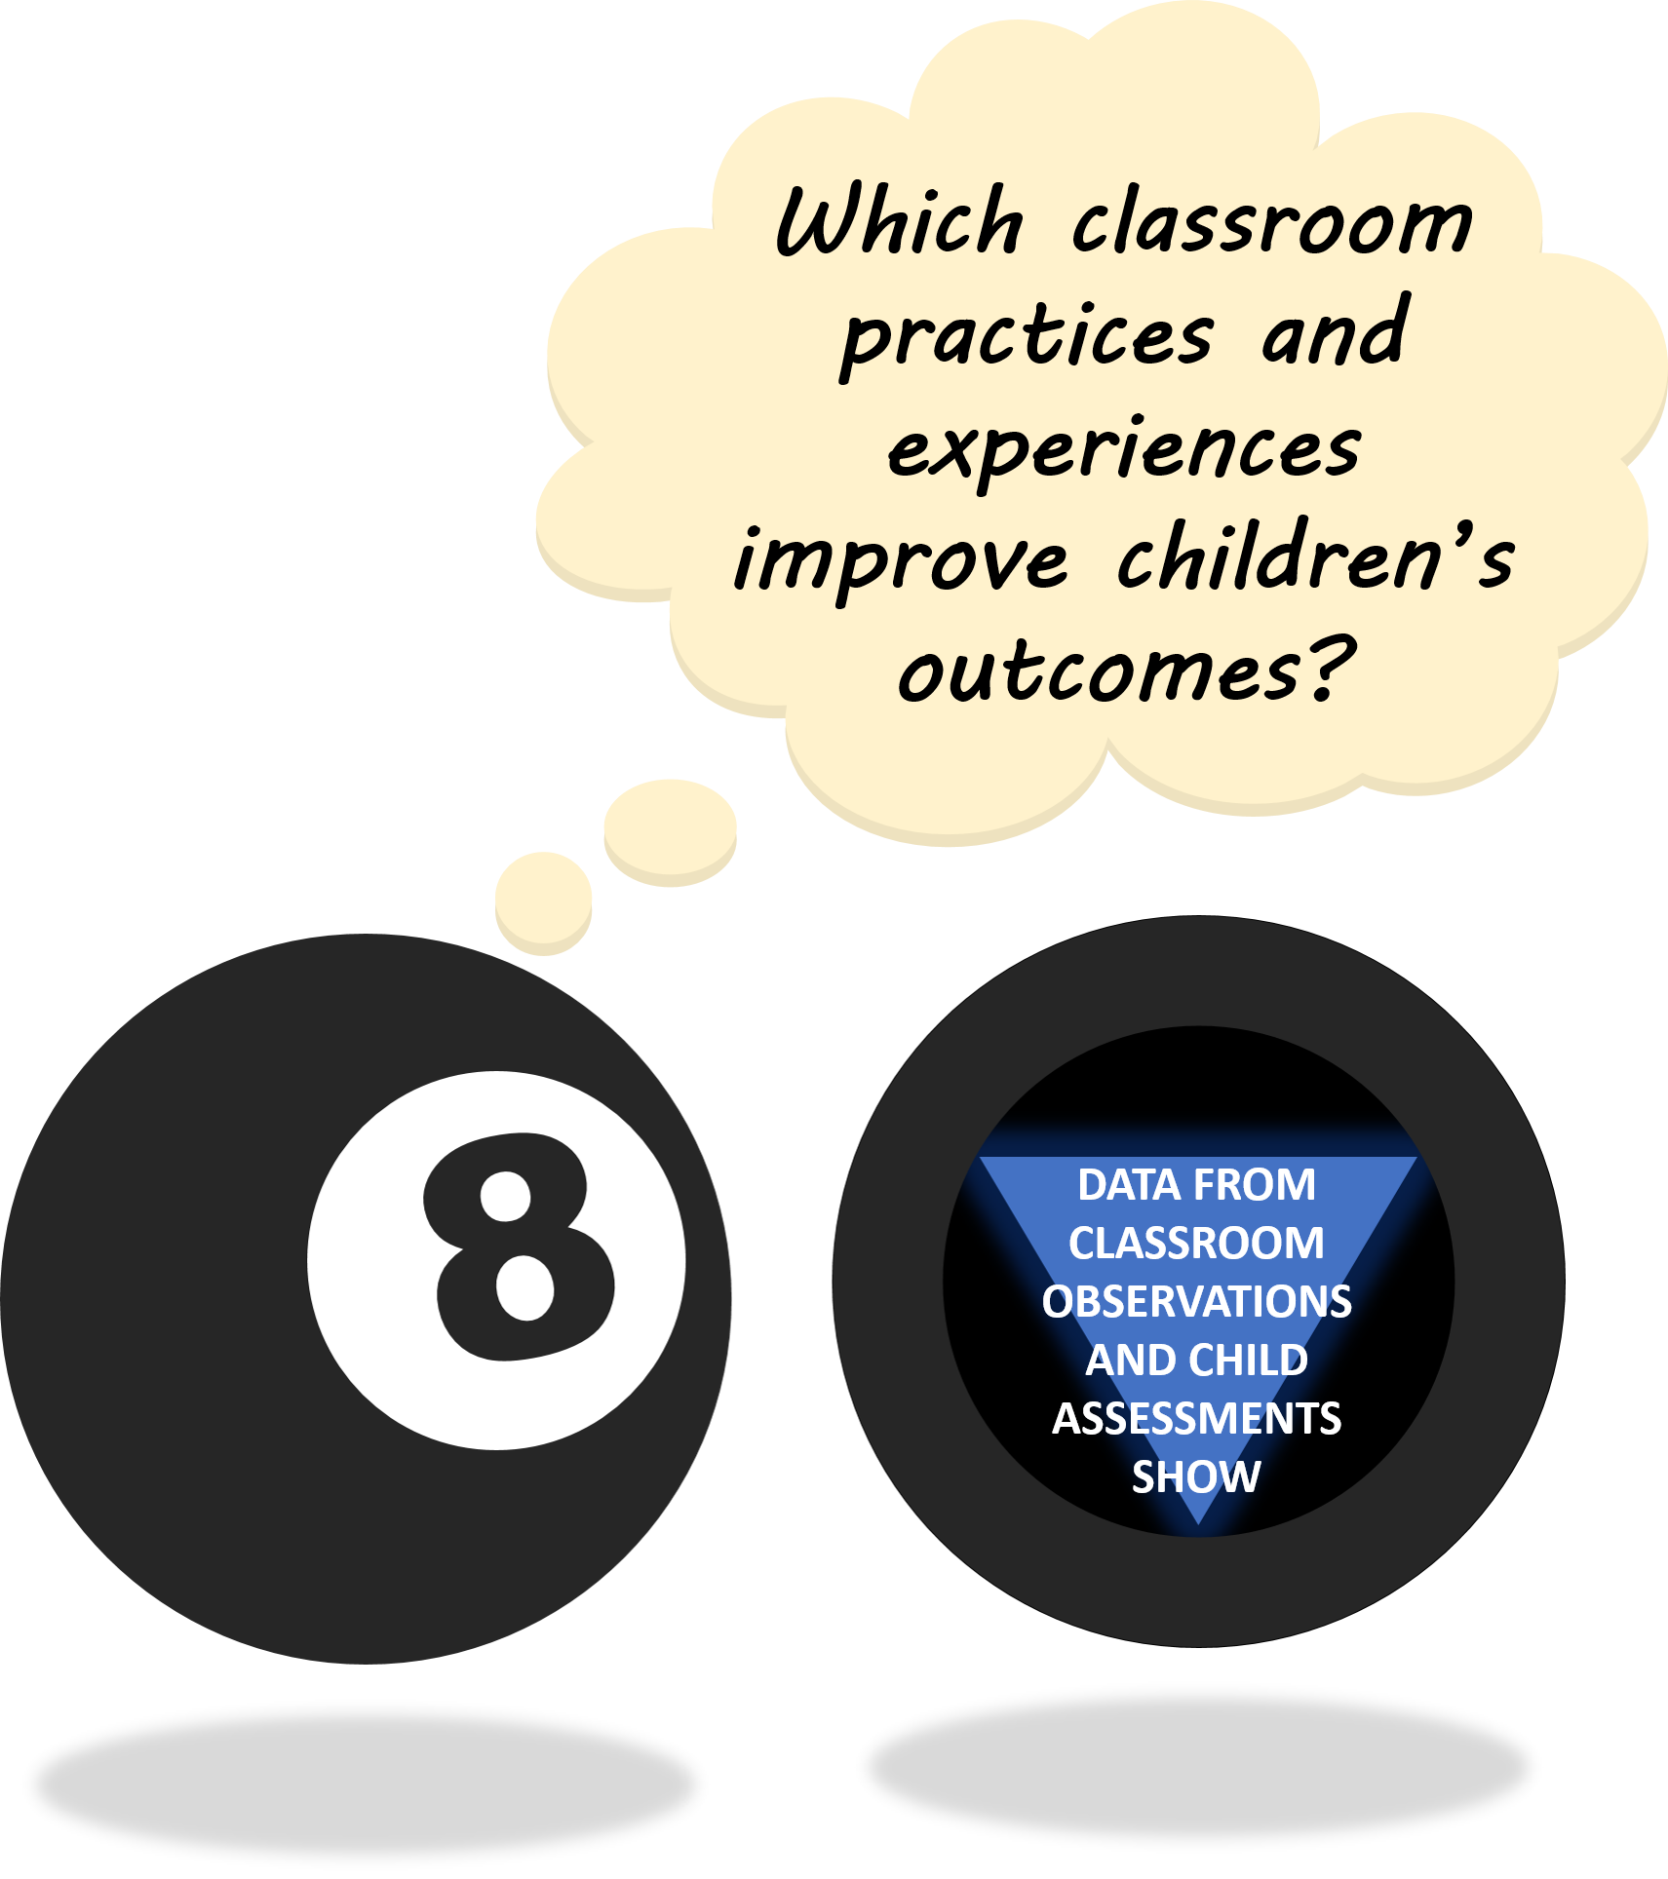
THE “MAGIC 8” CLASSROOM PRACTICES
Reduce time spent in transition
Creating a positive climate
Increasing teacher listening to children
Improving level of instruction
Promoting associative and cooperative interactions
Planning sequential activities
Providing math opportunities
Fostering high levels of engagement
★ 2017-18 Initiative: Focus on Literacy ★

Slide 3


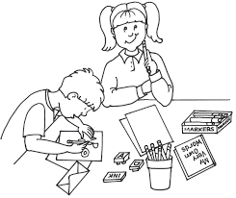
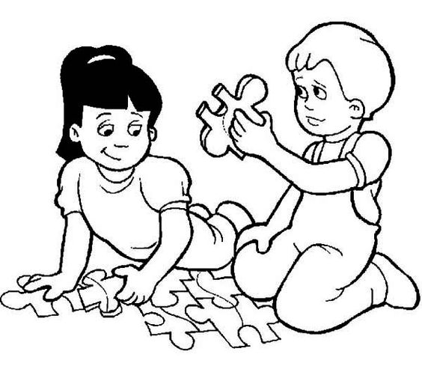
WHAT IS A SEQUENTIAL ACTIVITY?
Sequential activities require children to follow a logical order or sequence.
Non-Sequential
Sequential
EXAMPLES:
EXAMPLES:
Scribbling with markers in the writing center
Writing names, responding to a journal prompt, writing authentic messages
Squishing Play-Doh in the art center
Forming recognizable shapes, letters, or objects
Scattering pieces from different puzzles on the floor; animating pieces
Working on a puzzle together or alone; looking for pieces, rotating pieces to fit

Slide 4



WHY SEQUENTIAL ACTIVITIES ARE IMPORTANT
Dimensions of
Executive Function
Children need opportunities to interact with materials and engage in activities that require them to think, plan, and reflect.
Sequential activities provide important opportunities to practice executive function and self-regulation skills.
WORKING MEMORY
The ability to hold information in mind and use it.
Children who spend more time engaged in Sequential activities make greater gains in:
Early Math Skills
Letter and Sight Word Recognition
Emergent Writing Skills
INHIBITORY CONTROL
The ability to master thoughts and impulses so as to resist temptations, distractions, and habits, and to pause and think before acting.
COGNITIVE FLEXIBILITY
The capacity to switch gears and adjust to changing demands, priorities, or perspectives.
DISCUSSION POINT:
Which subject areas naturally lend themselves to more Sequential activities?
Notes:
CITE: developingchild.Harvard.edu (Enhancing and practicing executive function skills with children from infancy to adolescence – handout)

Slide 5

STRATEGIES FOR PROMOTING SEQUENTIAL ACTIVITIES
When setting up the classroom and choosing materials, teachers should strive to create opportunities for higher levels of cognition throughout the day, especially during center time.
Strategies include:
Incorporating Sequential Materials
(i.e., those that are self-correcting)
Previewing and modeling how to use materials in a Sequential way
Suggesting scenarios or goals to structure play

Slide 6
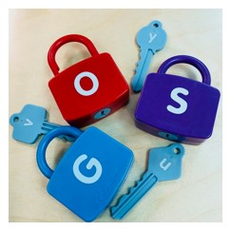

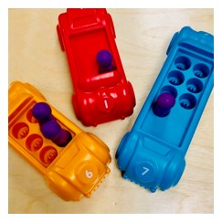


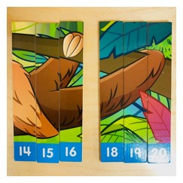
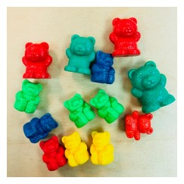
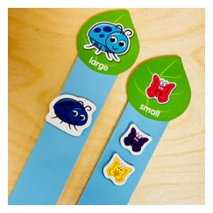
STRATEGIES FOR PROMOTING SEQUENTIAL ACTIVITIES: USE OF MATERIALS
Recall: Sequential ACTIVITIES require children to follow a logical order or sequence.
Sequential MATERIALS often give children visual feedback about whether the task has been completed successfully, and promote children’s independent, sequential play.
Can you identify which materials are sequential?
DISCUSSION POINT:
For materials that are not sequential, how can you support children’s use of them in a sequenced way?
Notes:
KEY: the rotated pics are nonsequential. All others are sequential.
NEXT STEPS: Come up with a plan to help children use one of your most popular nonsequential materials in a sequential way.
*Most Montessori materials are designed to be self-teaching/self-correcting (http://baandek.org/posts/self-teaching-self-correcting/)
*Materials that require matching (colors, shapes, sizes)
…something here about materials that match on two different characteristics, e.g. cards that are meant to match quantity and numeral might have the same color border to give child additional feedback
*Some materials are intrinsically SQ, while others may require input from teacher to suggest ways of using them in a more planful, SQ manner

Slide 7
STRATEGIES FOR PROMOTING SEQUENTIAL ACTIVITIES: SUGGESTING ACTIVITIES
While some materials are inherently sequential (e.g., puzzles), children may need suggestions or support from adults to use other materials in a sequenced way.
PREVIEWING
MODELING
Be intentional and enthusiastic when introducing free choice center activities—this is an excellent way to spark children’s interest and give them ideas!
Play alongside children and demonstrate using materials in sequenced ways:
I brought in a real MAILBOX for the Writing Center! You can write letters to your friends, put them in the mailbox, and the mail carrier will deliver them during our Afternoon Meeting.
I see the counting bears are having a birthday party! Should we count how many guests there are to make sure we have enough treats?
Since I’m the waitress,
I’ll write down your order.
Hmm…I can’t remember how to spell “pizza”, but I know it starts with the /p/ sound.
Which letter is that?!
Notes:
*Don’t ‘police’ children’s play
*Incorporate math, science, or writing into any activity/interest area

Slide 8
STRATEGIES FOR PROMOTING SEQUENTIAL ACTIVITIES: ENHANCING SCENARIOS
Integrate topics from curriculum studies across daily activities
Suggest scenarios for children to act out during dramatic play
Help children develop plans for making specific structures in the block area
DISCUSSION POINT:
How can you follow children’s interests to scaffold sequential activities?
Notes:
Add speech bubble examples
*messages for upcoming holidays
*taking orders during dramatic play
*creating plans for a building in block area

Slide 9
STRATEGIES FOR PROMOTING SEQUENTIAL ACTIVITIES: ADDITIONAL EXAMPLES
ADDITIONAL EXAMPLES:
Non-Sequential | Facilitation | Sequential
Children scatter pieces from different puzzles on the floor | Teach strategies for putting together difficult puzzles (e.g., “Let’s look at the picture on the box…these three pieces are red like the firetruck. I wonder if they belong together.”) | Children work on a puzzle together or alone—looking for pieces, rotating pieces to fit
Children randomly and quickly flip through the pages of a book | Use self-talk to model how they approach reading a new book. Model strategies for using pictures to “guess” what the story is about. | Children “read” books, turning pages and making comments about pictures
Children squish play-doh in the art center | Introduce art center by suggesting the kinds of things children might want to try making. | Children use play-doh to make shapes such as letters, leaves for a tree, or cookies for a bakery
Children scribble with markers in the writing center | Think about how written text can be related to a unit theme or study. Suggest that children write letters, make lists, or author stories. | Children work on their names, a journal prompt, or writing authentic messages
Children play together with dinosaur counters, making sounds and talking like dinosaurs | Prompt children to make comparisons about quantity (e.g., “Who has more dinosaurs? How can you tell? How can we make these groups equal?”) | Children count the dinosaurs and/or sort them into groups based on size, color, or some other characteristic
Children are knocking down structures in the block center | Help children make plans or blueprints for buildings. Provide pictures or diagrams in the block center to help give children ideas. | Children carefully stack blocks to make recognizable shapes and structures
Children are using the dramatic play area as a “kitchen” | Create variety in the dramatic play center by setting up different scenes. Discuss responsibilities of specific jobs in the community (e.g., “What do people do at the grocery store? How does a post office work?”) | Children take on the different roles in an ice cream parlor or pretend to follow a recipe
Notes:
Add speech bubble examples
*messages for upcoming holidays
*taking orders during dramatic play
*creating plans for a building in block area

Slide 10

SPECIAL THANKS & ADDITIONAL RESOURCES
We are grateful to the following MNPS Pre-K Instructional Coaches and Multi-Classroom Leaders for their invaluable feedback in developing these materials:
SeTara DeThrow
Carrie Head
Susan McClain
Stephanie Mullins
Holly Stone
Ashley Aldridge Wilson
Rhiannon Wilson
https://my.vanderbilt.edu/mnpspartnership/
Notes:
What are some materials that you notice children frequently playing with in non-sequential ways?
How can you encourage Sequential play without interrupting or taking over children’s interactions?
Which subject areas naturally lend themselves to more Sequential activities?

Slide 11
INDIVIDUAL IMAGE SOURCES
FREQUENTLY USED IMAGES*
ADDITIONAL IMAGE SOURCES
Lightbulb | myiconfinder.com
Designed by Vexels.com:
Hand drawn magnifying glass
Hand drawn bar graph
Pie chart hand drawn doodle
Hand drawn wall clock
Hand drawn cloud bubble
Hand drawn open book
Cog wheel hand drawn icon
Slide 3: writing center | weclipart.com
Slide 3: puzzle | getcolorings.com
Slide 4: child gear head | DeviantArt.com
Slide 4: arrow | clipartstockphotos.com
Slide 5: doctor | getcolorings.com
*These graphics are used as icons throughout the series. For example this lightbulb clipart appears beside most “Discussion Point” questions.

